Slide 1

The Battle of Neighborhoods- Finding Common Venues in Toronto and New York City

Slide 2
Introduction
Toronto and New York being the financial capital of Canada and the US respectively are one of the densely populated cities in the world. Both these cities see a lot of diversity resulting from the movement of a lot of immigrants from several parts of the world for work and settlement. These are one of the most immigrant-friendly cities, still different in so many aspects, which we are going to observe in this work.

Slide 3
Data and Problem-solving strategy
The idea is to compare Toronto and the New York region for their similarities difference in terms of the most common venues they have. I will investigate the number of cuisines, Restaurants, coffee shops and other features in both cities as well as list down the 5 most common venues in both cities Neighborhood wise. The outcome of this study will help tourists and new immigrants have an overview of the common venues in both cities and chalk out the differences between both, which might further help them in their decision of travel or immigration choice.
Then explore both cities by using Foursquare API and K-Clustering Approach and visualize the results separately.

Slide 4
Results

Slide 5
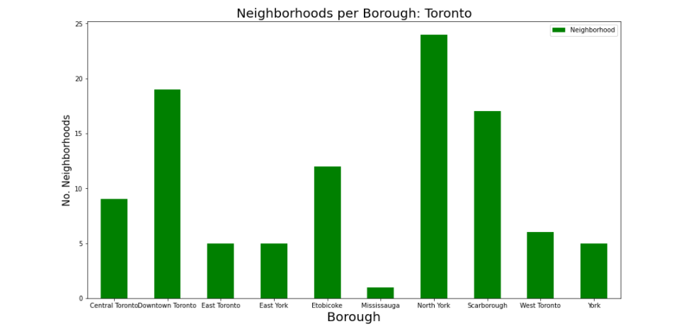

Slide 6
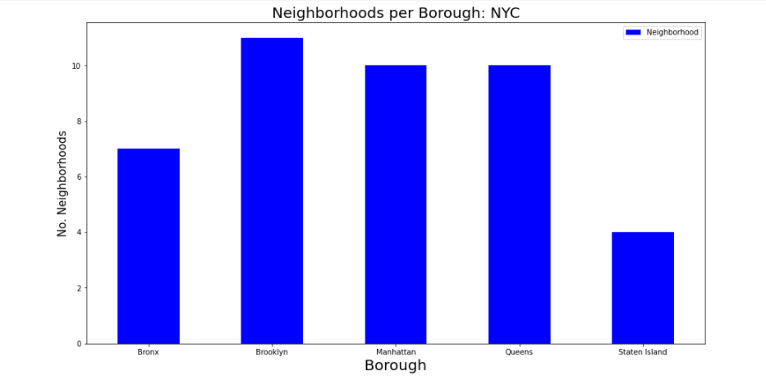

Slide 7
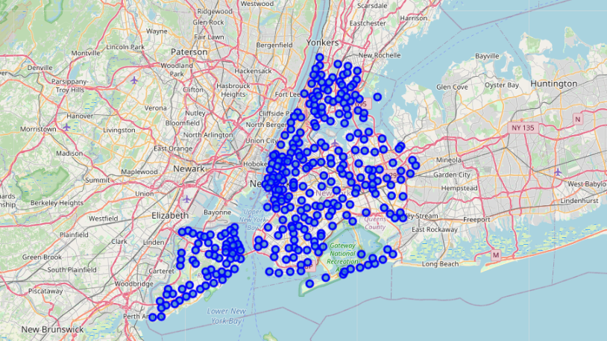

Slide 8
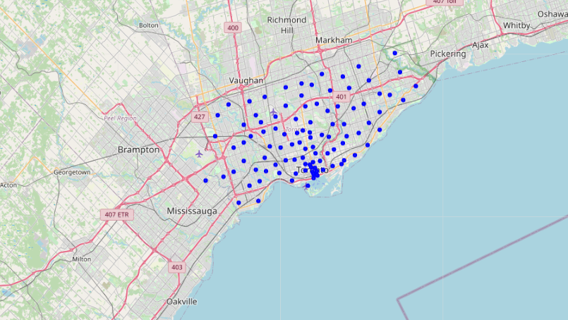

Slide 9
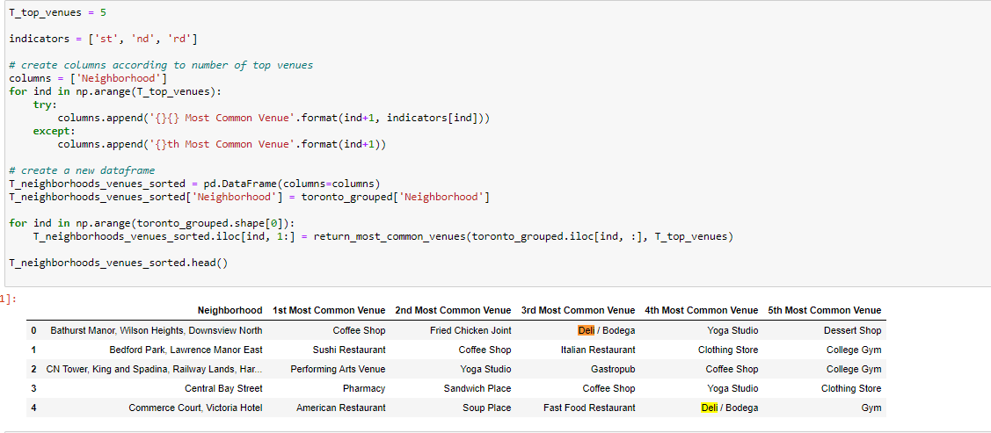

Slide 10
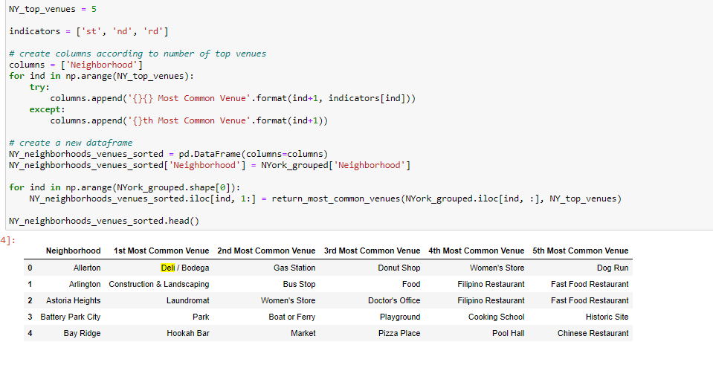

Slide 11
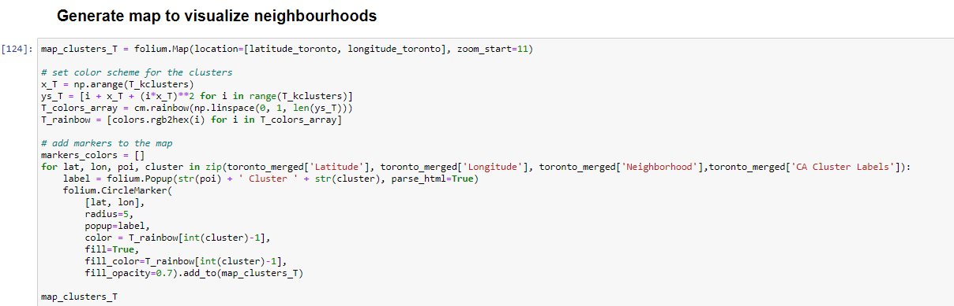

Slide 12
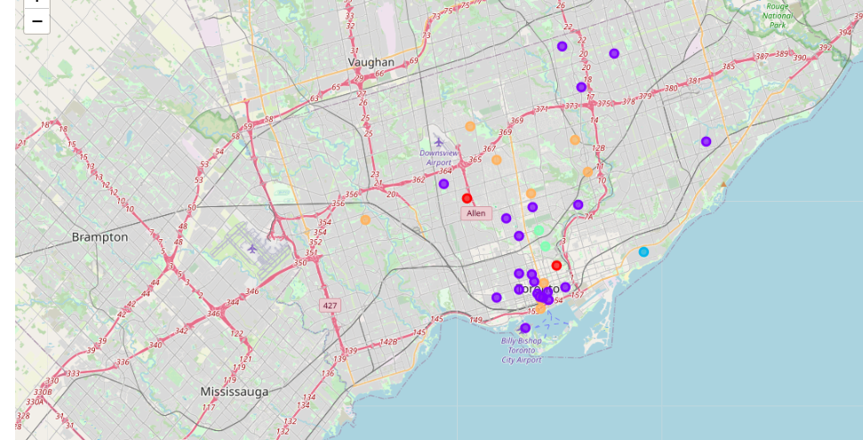

Slide 13
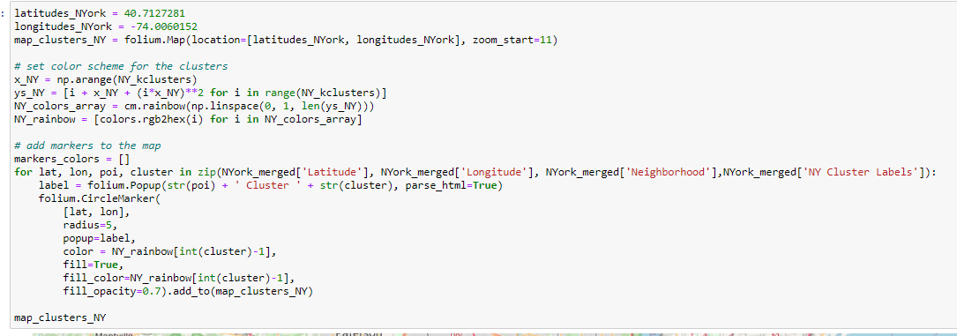

Slide 14
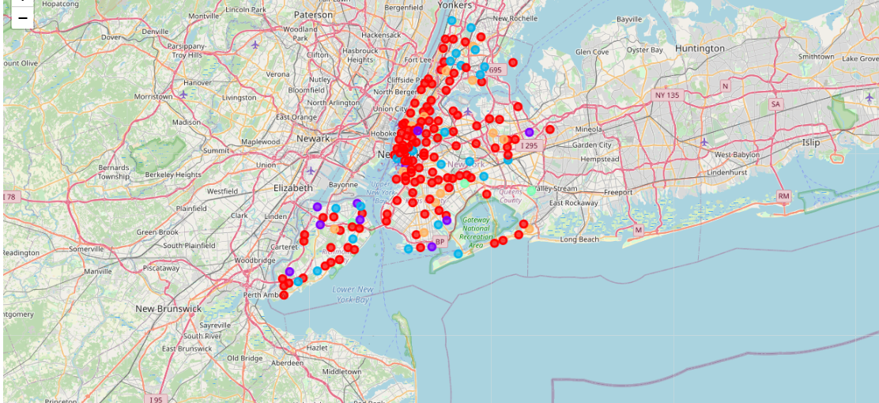

Slide 15
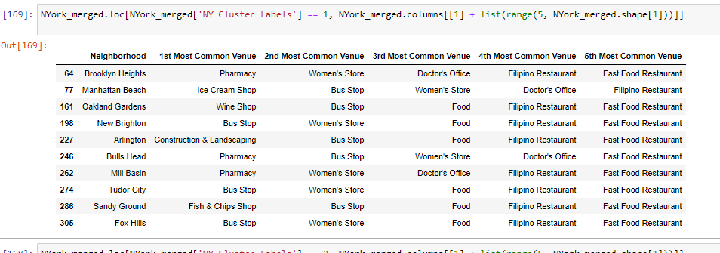

Slide 16
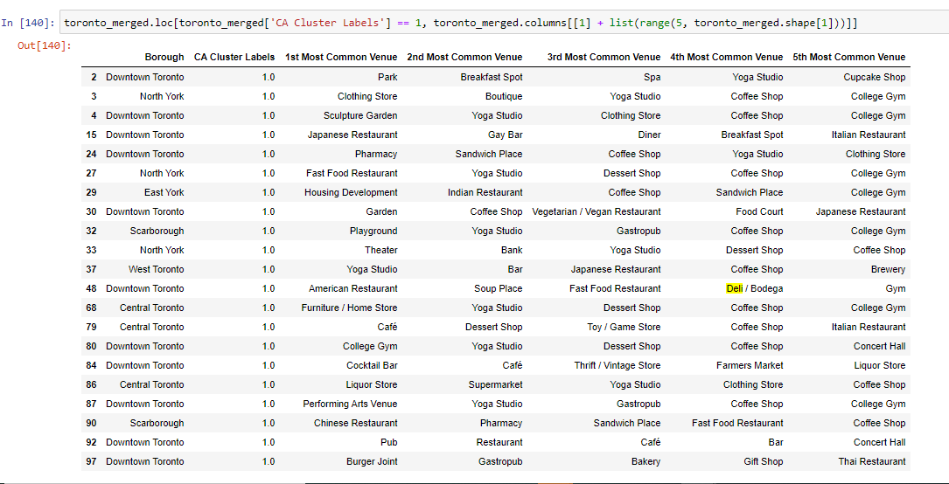

Slide 17
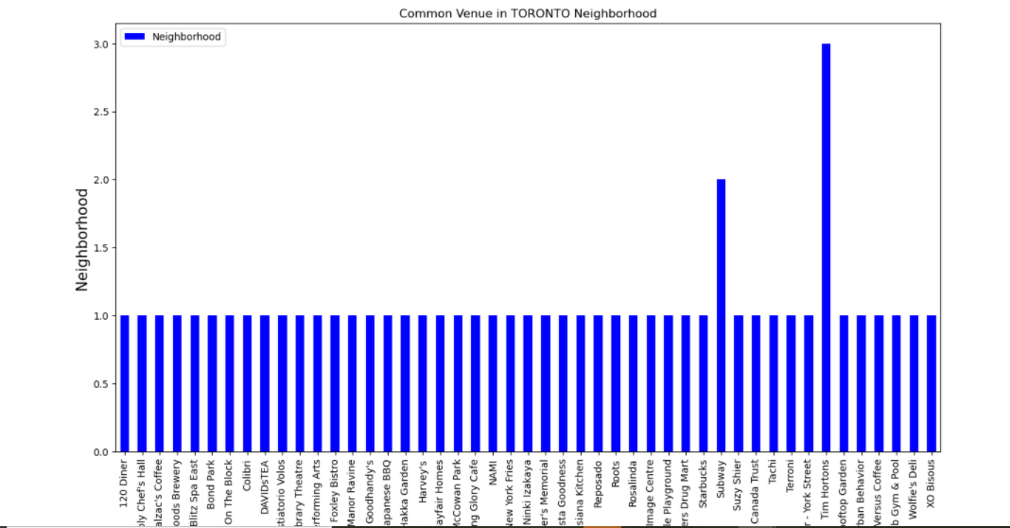

Slide 18
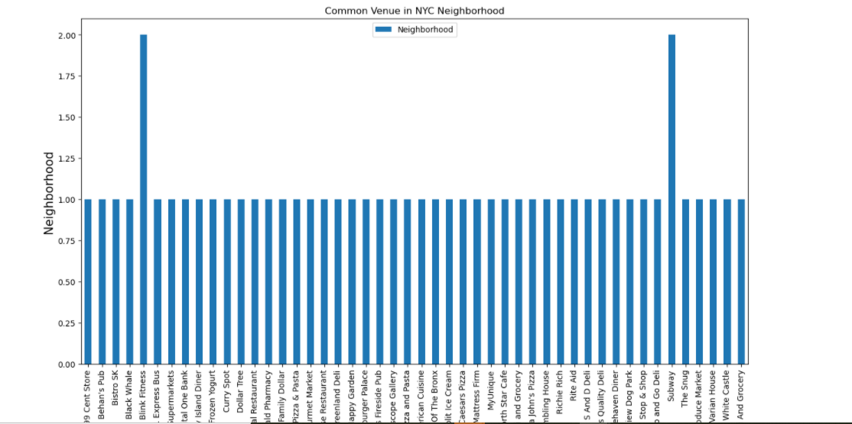

Slide 19
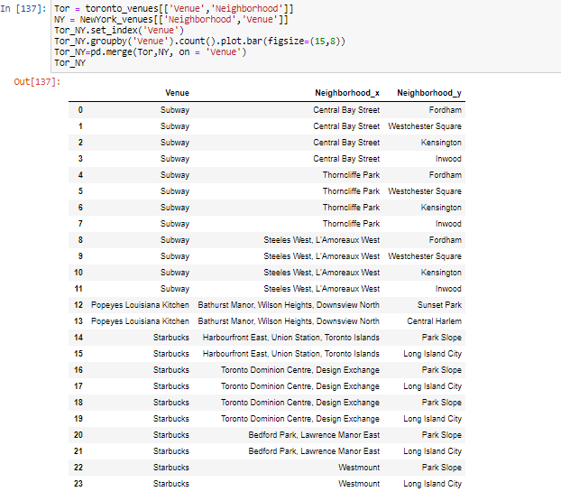

Slide 20
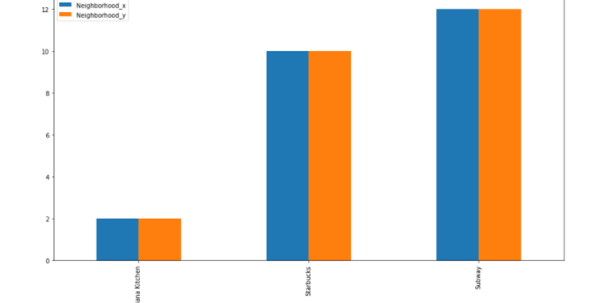

Slide 21
Conclusion
After doing K Clustering, it appeared that Italian Food, Deli/Bodega, fast-food Restaurant and many other places were in common in both Toronto and New York City neighborhoods. However, the most common venues are Popeyes, Starbucks and Subway. As we know that every place is unique, so that’s argument is present in both neighborhoods. The dissimilarity exists in terms of some different venues and facilities but not on a larger extent.

